Slide 1
HND Computing Systems Development: Object Oriented Analysis and Design (H172 35)
Lecturer – Dawn Wilson

Slide 2
Use Case - Review
A use case describes how a type of user (called an actor) uses a system to achieve a goal
Who will be using the system? – doesn’t have to be human, could be another external system
What will they be using it to do? – the goal must be of value to the actor i.e. we wouldn’t have a use case called “cardholder enters PIN” as this by itself has no value to the cardholder
What is the overall aim of using use cases?
To eliminate rework due to requirements misunderstandings
Use cases in conjunction with techniques like storyboarding, help to build explicit shared understanding between the clients and the development team

Slide 3
Diagramming Use Cases
UML Use Case diagram
Diagram multiple use cases and actors together to give an overview of the system and how they interact in context
UML Notation:
Stick figures to represent an actor
Elipses around use case titles
Rectangle around all use cases to show system boundary (can also be useful to use boxes to denote releases)
Draw lines (association) between actors and use cases they interact with
If actor supplies information, initiates the use case, or receives information as a result of a use case then need an association
N.B. this does not represent flow of information therefore no arrow heads (information flow can be modelled using UML activity diagrams)

Slide 4
Diagramming Use Cases
Not all actors are humans, may be an external system. This should be represented by a box (rather than a stick figure), but include the notation <<actor>> at the top of the box
Typically (not a rule), put primary actors (initiate use case) on the left hand side and secondary actors on right
There is no sequence of use cases, but if the app. has a flow then can diagram them top to bottom
It is a simple overview of multiple actors and use cases at the same time without any specific details. Good for communication and assists with identifying missing actors/use cases

Slide 5
Linking Use Cases
Association relationships
Basic relationship to show an interaction between actor and use case OR use case and use case
Generalization relationships
One element (child) "is based on" another element (parent)
Include relationships
One use case (base) includes the functionality of another (inclusion case)
Supports re-use of functionality
Extend relationships
One use case (extension) extends the behaviour of another (base)

Slide 6
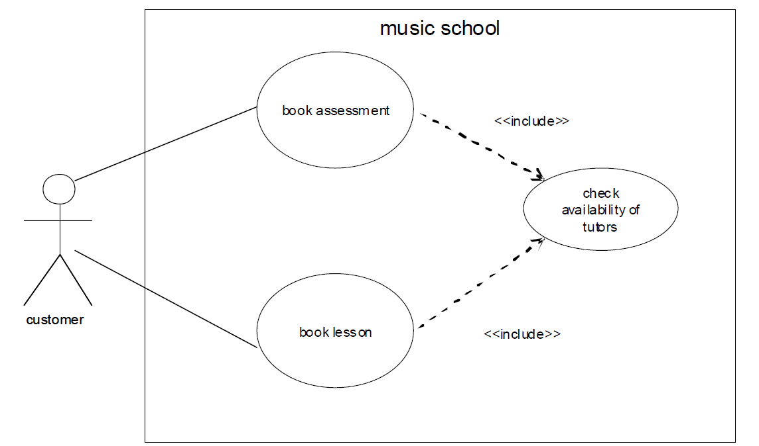

Linking Use Cases
Include
You have a piece of behavior that is similar across many use cases
Break this out as a separate use-case and let the other ones “include” it
Included use case never stands alone

Slide 7
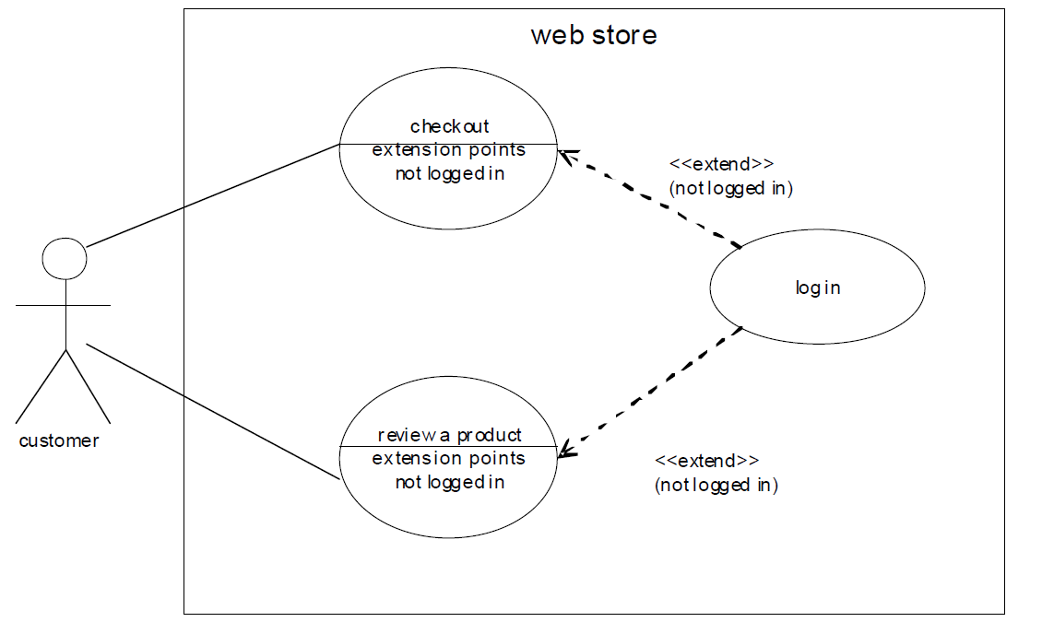

Linking Use Cases
Extends
A use-case is similar to another one but does a little bit more
Put the normal behavior in one use-case and the exceptional behavior somewhere else
The base use case may stand alone, but under certain conditions its behaviour may be extended by the behaviour of another use case

Slide 8
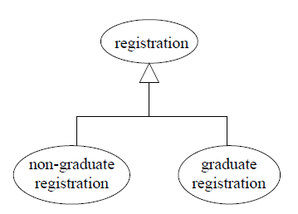
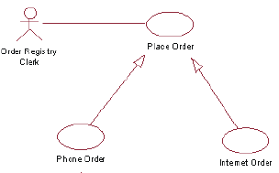
Linking Use Cases
Generalization
The child use case inherits the behaviour and meaning of the parent use case.
The child may add to or override the behaviour of its parent

Slide 9
UML notation for associations
Association shows an interaction and this is represented as a solid line connecting the interacting elements.
<<include>> means always included. The association is a dashed line annotated with <<include>>, pointing towards the use case being included
<<extend>> means conditionally included. The association is a dashed line annotated with <<extend>> , pointing towards the use case being extended (and not the extending use case)
generalisation shows the child inheriting the behaviour of the parent. The association is a solid line with an empty arrow head pointing towards the parent

Slide 10
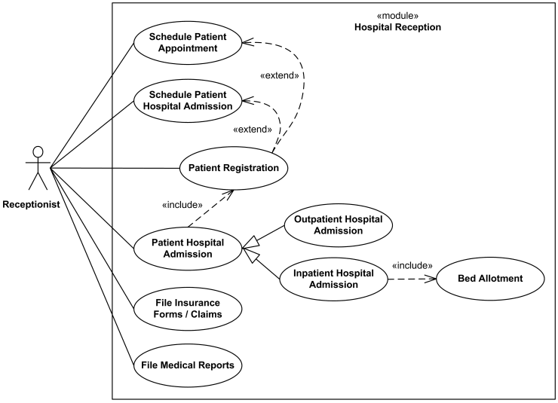

Slide 11
Activity
Suppose we want to develop software for an alarm clock. The clock shows the time of day. Using buttons, the user can set the hours and minute fields individually, and choose between 12 and 24-hour display. It is possible to set an alarm. When an alarm fires, it will sound some noise. The user can turn it off, or choose to ’snooze’. If the user does not respond at all, the alarm will turn off itself after 2 minutes. ’Snoozing’ means to turn off the sound, but the alarm will fire again after some minutes of delay.
Identify the top-level functional requirement for the clock, and model it with use cases and a use case diagram

Slide 12
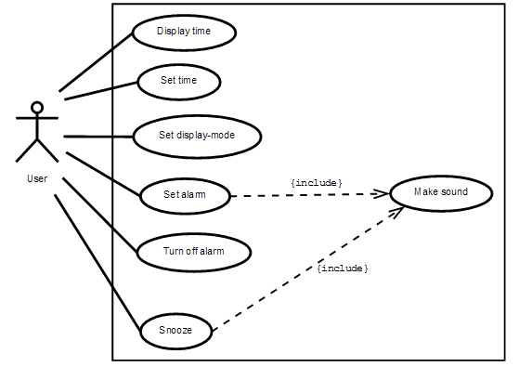

Slide 13
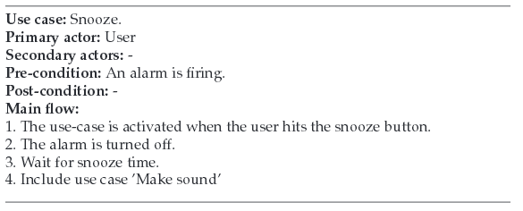

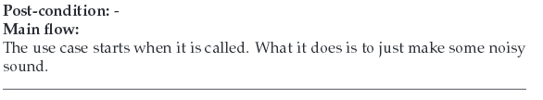

Slide 14
